Slide 1
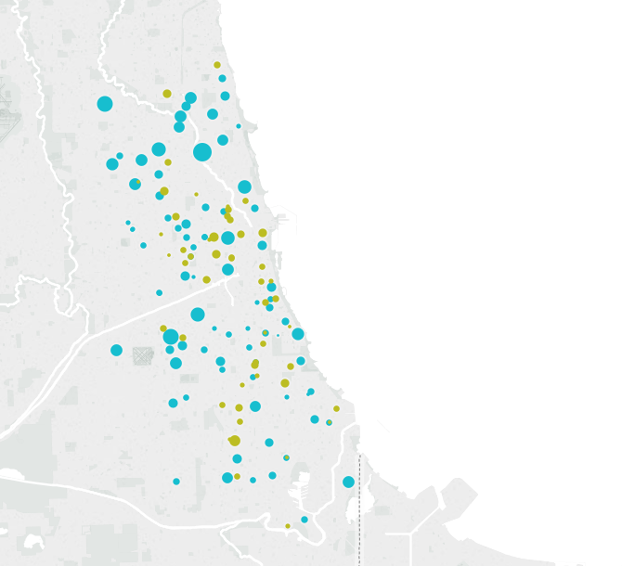

We’re working with
to create a better model to predict school-level enrollments.

Slide 2
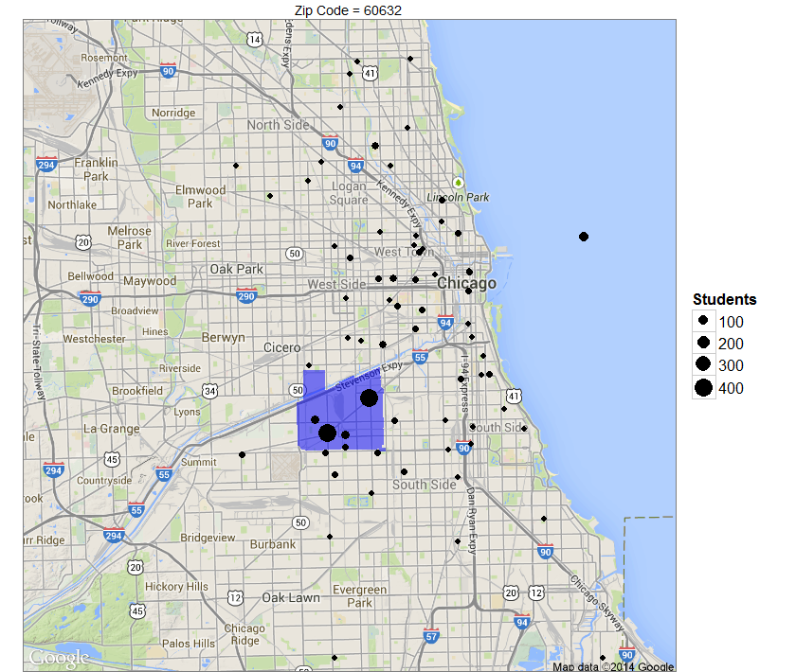

Slide 3
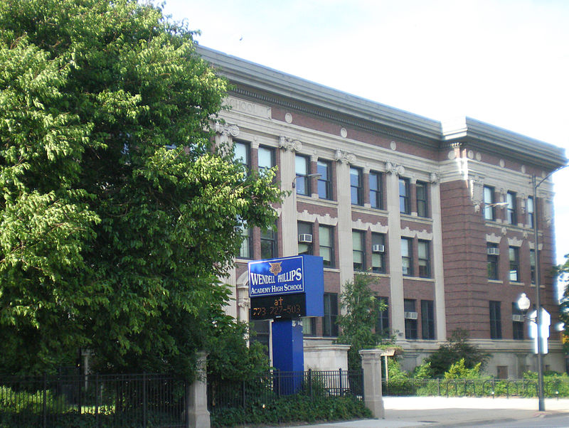


600 schools and 400,000 students:
What data do we have to solve this problem?
School-level data
Performance rating
Historical enrollment
Student-level data
Public-use data (e.g., crime)
Photo sources: wikipedia, CPS website, Chicago data portal

Slide 4
How we’re tackling the problem:
Creating smaller solutions.
What happens when…
A new school opens?
A school closes?
A school relocates?

